Slide 1


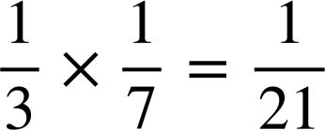
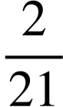



Calculating theoretical probabilities from probability trees (two events)
Task A: Probability of an outcome from a two-stage trial
1) Spinner 1 is spun several times.
The spinner landed on R
of the time.
Spinner 2 is spun several times.
The spinner landed on G
of the time.
Trial: spinning spinner 1 and spinner 2 once each.
Complete the probability tree to calculate the probability of each outcome from this trial.
G
R G
R
R
G
T
H
spinner 1
spinner 2
2) Trial: spinner 1 and spinner 2 are spun once each.
This probability tree currently shows all the outcomes on spinner 1.
a) Modify this probability tree so that it shows the sample space and probability of each outcome of this trial happening.
A
b) What is the probability of the outcome C Q happening?
T
A
C
Q
B
C
T
B
Q
A
A
T
A
B
spinner 1
spinner 2
T

Slide 2
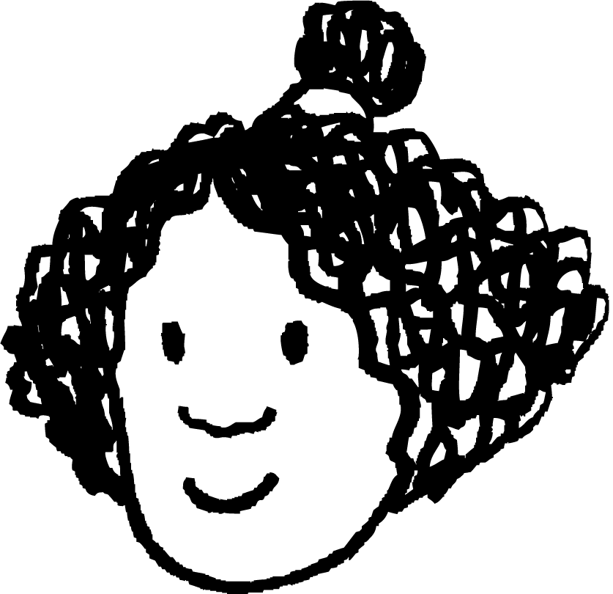






Calculating theoretical probabilities from probability trees (two events)
3) Lucas, Izzy, and Laura each take two flower seeds from a packet to grow.
The probability of each type of flower growing is written on the packet.
2 roses
1 violet
1 daisy
1 rose
1 daisy
Izzy
Lucas
Laura
grow
grow
violet: 80%
Lucas’ tree
not
grow
rose:
grow
not
grow
daisy: 90%
stage: plant the violet seed
not
grow
Construct three probability trees (one each for Izzy, Lucas, and Laura) which show the probabilities of their two flowers growing.
Task B: Probability of an event from a two-stage trial
1) A coin is flipped several times. On 45% (or 0.45 as a decimal) of trials, the coin lands on heads. Trial: flipping this coin twice.
0.45
head
a) What is the probability of the outcome “two heads”?
head
head
head
0.2025
0.45
0.55
tail
0.2475
b) What is the probability of the event that at least one coin lands on a heads?
head
tail
0.55
0.45
head
tail
head
0.2475
c) What is the probability of the event that exactly one coin lands on a tails?
tail
0.55
tail
tail
0.3025
tail

Slide 3



Calculating theoretical probabilities from probability trees (two events)
2) A different coin is flipped several times. On 53% (or 0.53 as a decimal) of trials, the coin lands on heads. Trial: flipping this coin twice.
head
Event 1: landing on heads twice.
Event 2: landing on exactly one head.
head
head
head
a) Complete the probability tree and sample space.
0.53
tail
head
tail
b) Which of these two events is more likely to happen?
And by how much?
tail
head
tail
tail
3) Lucas is playing a video game, and needs to scare away a cowboy using either his dragon or unicorn.
The probability of a character hitting their opponent is shown by their “accuracy” stat.
In order for Lucas to scare away the cowboy, either Lucas’ character has to hit, or the cowboy has to miss (or both).
By constructing two probability trees, find out whether the dragon or unicorn is more likely to scare away the cowboy.
dragon
accuracy: 80%
cowboy
accuracy: 60%
unicorn
accuracy: 60%
cowboy
accuracy: 25%
Mathematics in Education and Industry
v2.3

